Slide 1
QMSS PRACTICUM:
KPMG COVID-19 Intelligent Forecasting
Data Visualization Assignment
Louisa Ong (lo2352)

Slide 2
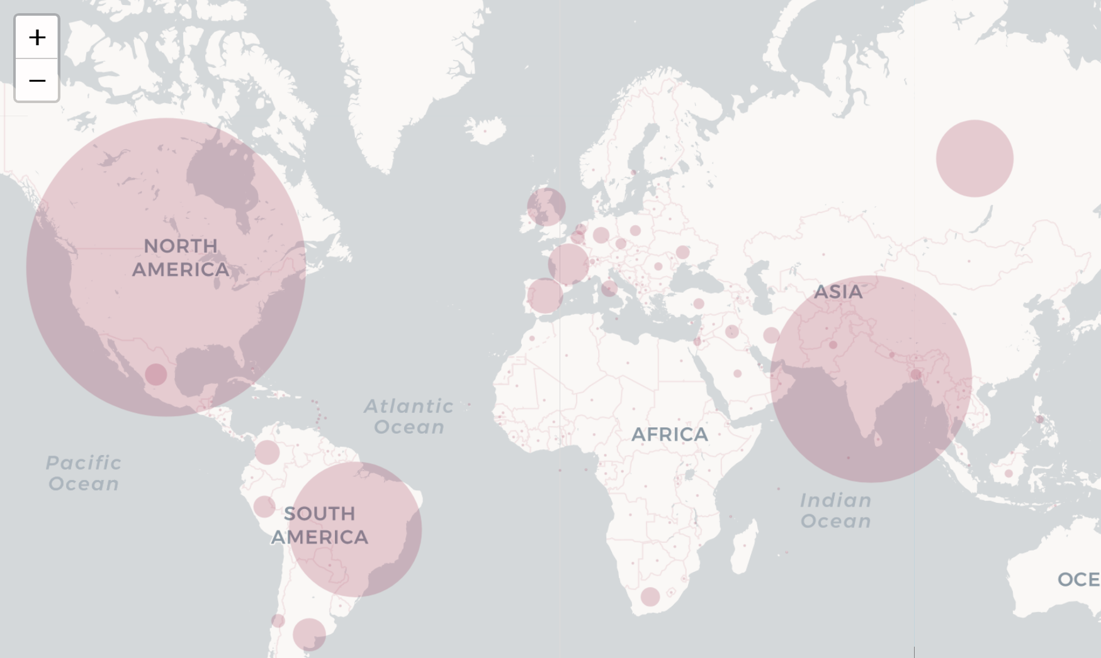
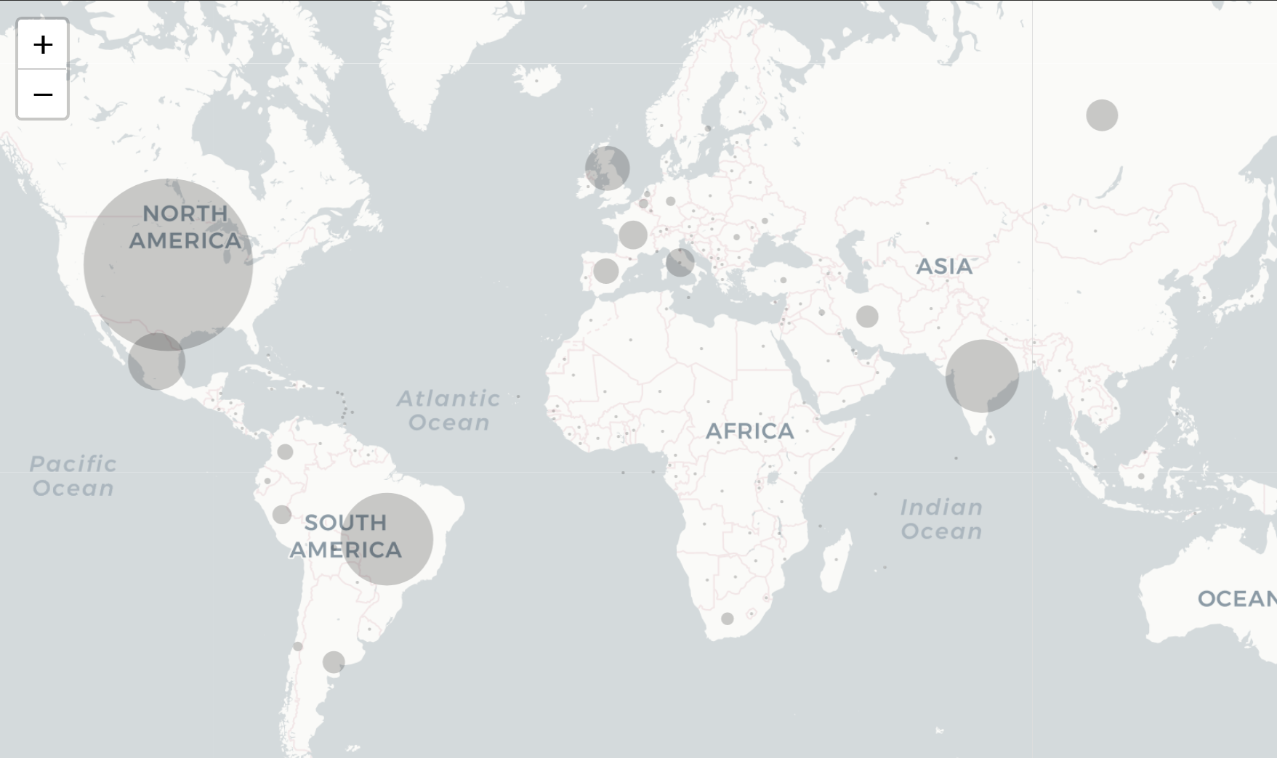
Radius Bubble Map (Cases, Deaths)
These two radius bubble maps show the total distribution of cases (in pink) and deaths (grey) worldwide. Such a visualization allows for us to understand the situation quickly.
We can identify certain geographical cluster hotspots such as in Europe, and we see that the number of deaths are more pronounced in U.K. than in France and Spain, although they have similar scale of number of cases.
We can also identify that while the number of cases in India seems to be nearing the level of U.S.’ and is much larger than Brazil, the number of deaths are far lower.

Slide 3
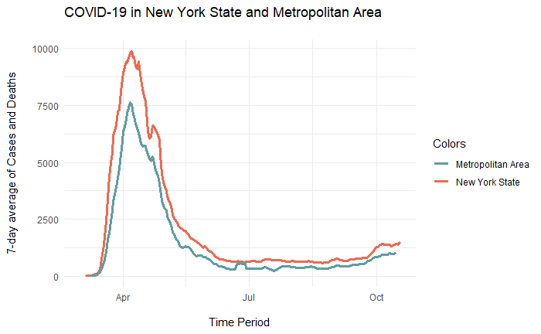
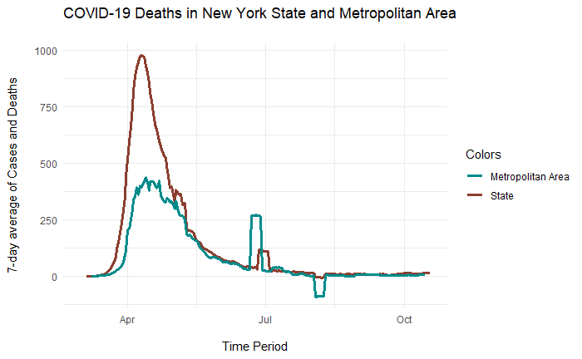
Metropolitan Areas (New York)
A first comparison between the Metropolitan Statistical Area, New York City-Newark-Jersey City (NY-NJ-PA) in blue and the figures of New York State in red is done, shown here in a time series graph of the rolling 7-day average of the number of cases or deaths per day.
The intention behind this is to provide more granular insight onto our data for the state, as for some states, the areas with high population density, i.e. the metropolitan statistical areas, are responsible for the majority of cases in the state , but in some other states, most of the cases stem from the suburban areas.
For this case, the New York City Metropolitan Statistical Area figures follow rather closely in comparison to the rest of New York State, though with some exceptions for deaths in early April, meaning that these came from the more rural areas of New York State.

Slide 4
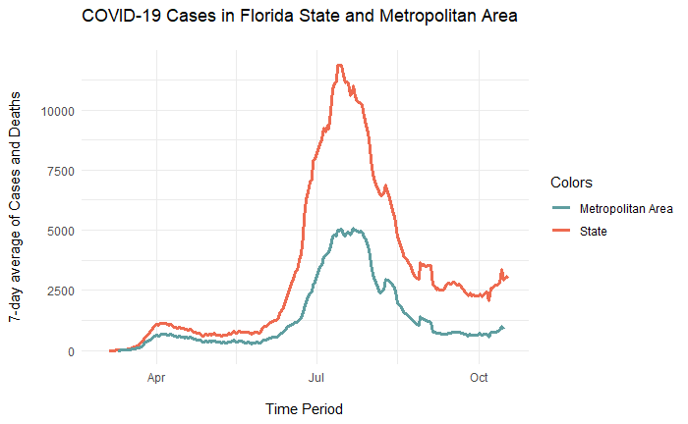
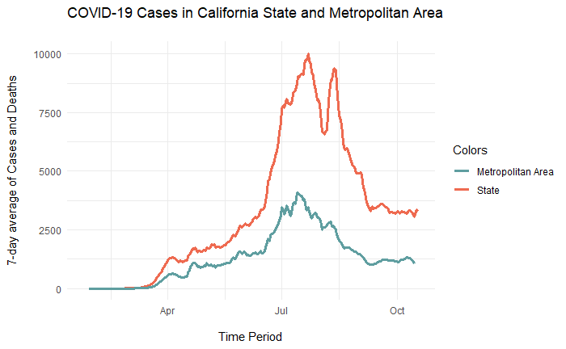
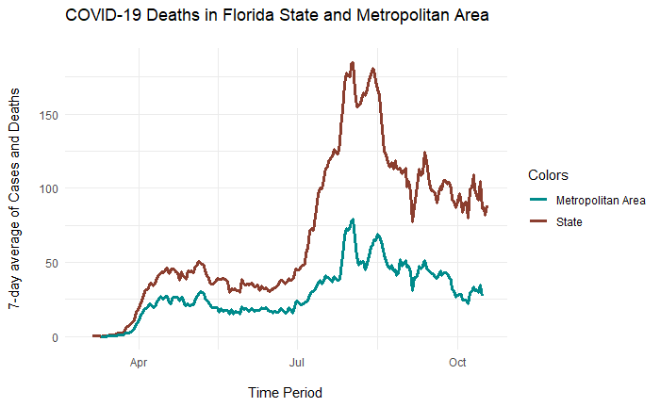
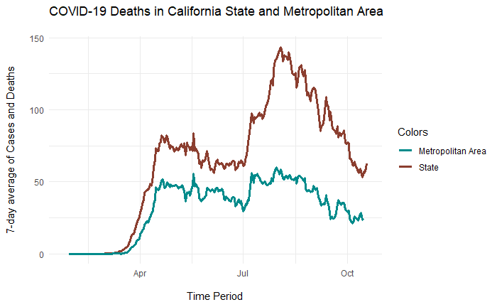
Florida and California
The comparison between these two states allow us to see both waves of cases and deaths, where the latter is much more severe than the former. The first wave had not completely been controlled before the second wave struck, though according to the data, it has since subsided from its peak.
In comparison with the main metropolitan areas of each State, that is Los Angeles-Long Beach-Anaheim in California and Miami-Fort Lauderdale-Pompano Beach in Florida, the cases in metropolitan areas rose along with the total state cases, but it was much less so in the second wave. Especially in comparison with how it has been in New York, where cases were very close to the state total, we can conclude that a significant proportion (more than half) of the cases and deaths in this second wave come from non-metropolitan areas.

Slide 5
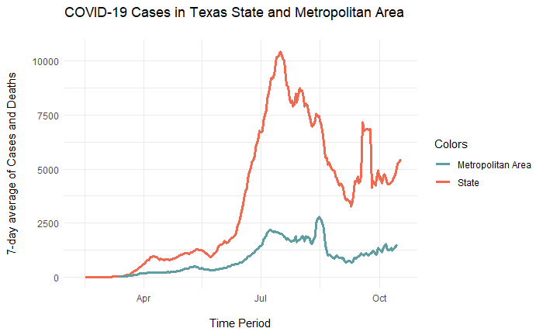
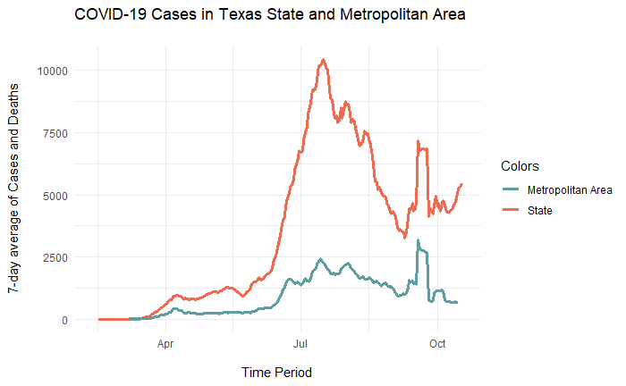
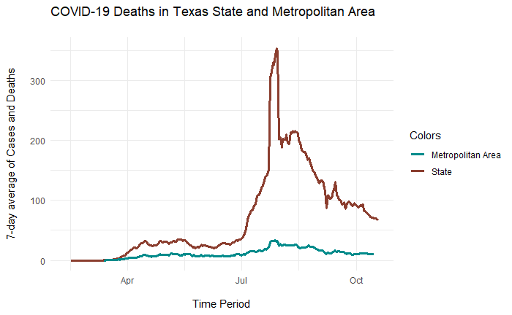
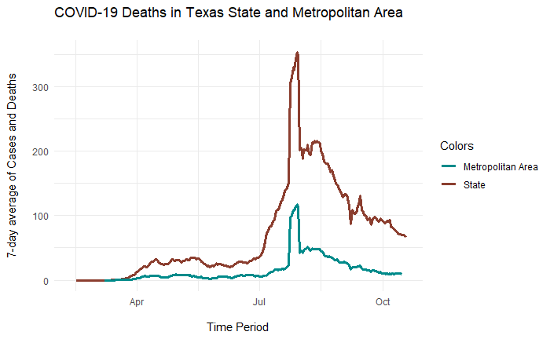
Dallas and Houston, Texas
DALLAS
HOUSTON
The two metropolitan areas of Texas, Dallas-Fort Worth-Arlington and Houston-The Woodlands-Sugar Land are the metropolitan areas with the highest number of cases in the entire country. Even then, comparing with the total number of cases in the state, we see that they are not responsible for the majority of cases in Texas.
Furthermore, the sharp increase in deaths were hardly influenced by Dallas, unlike in Houston. We see stronger trend similarities between Houson and the overall state of Texas’ cases and deaths, suggesting that what happens there has a more influential impact than what happens in Dallas.

